Slide 2
Content and Schedule time every day (to be modified by each country team):
09:00 – 11:00 Working Part 1 (2 hrs.)
11:00 – 11:30 Coffee Break
11:30 – 13:30 Working Part 2 (2 hrs.)
13.30 – 15.00 Lunch
15.00 – 17.00 Working Part 3 (2 hrs., Homework and Social Activities)
Day 1:
Presentation about the Math-GAMES Project
Math-GAMES Market Place (partner bring games and other things for display, partner introduction)
Presentation about the Math-GAMES Didactics and Methodology
Math-GAMES Portal-Website
Explanation of the Synopsis
Presentation of GAMES
Presentation of Online Game Tools
Day 2:
Presentation of different games via lesson plans
First practice games, second learn about Mathematics
Day 3:
Presentation of games via lesson plans
Practice and assignment (prepare a lesson, in groups of 3 participants)
Day 4:
Trainees deliver the above prepared lessons in groups of 3 (30-40 min each)
Day 5:
Trainees deliver lessons
Discuss ideas for dissemination and promotion
Evaluation

Slide 3
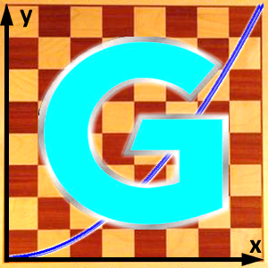
The 3 Target Groups of the European Erasmus+ Project Math-GAMES
How games can help learning Mathematical Literacy
learning to count and calculate
learning basics in Mathematics, Statistics and Geometry
Members of the
Math-GAMES
Project Group
Teachers in Europe,
who are teaching basics in Mathematics
Students in Europe,
who are attending classes for basics in Mathematics
Specialists from 10 countries are working out the material for the Math-GAMES project.
Everything can be downloaded from the website:
www.math-games.eu
in the languages BG, DE, EN, ES, EL, FR, IT, RO, VA, TR
Teachers in Europe, who are working in Adult-Education or in other educational fields for people who want to learn basics in Mathematics, can use the Math-GAMES didactic material.
Students in Europe, who want to learn basics in Mathematics, e. g.
Adults (old and young)
Migrant people
People, who had not the chance to visit a school
People, who have forgotten the knowledge of mathematics and need it in their profession

Slide 4
Structure of the
European Erasmus+ Project Math-GAMES
How games can help learning Mathematical Literacy
learning to count and calculate
learning basics in Mathematics, Statistics and Geometry
Math-GAMES Compendium
Books and e-Book (in 9 languages)
Math-GAMES
Guidelines
Books and e-Book (in 9 languages)
Math-GAMES
Teacher Training Course
Seminar and e-Presentation (in EN)
More than 30 games with description
Rules
Pictures
Graphics
Relevance for Mathematics
Guidelines to each of the games in terms of Mathematics
Didactic and methodological notes for teachers
Structure of each lesson, step by step
Templates for the games
How to make games themselves
Teacher Training Course to work with Math-GAMES
Didactic and methodological notes for teachers
Structure of each lesson, step by step
Templates for the games
How to make games themselves
Videos on YouTube
Talk on Facebook
Presence Training
e-Presentation
Math-GAMES
Evaluation Report
(e-Book in EN)

Slide 5
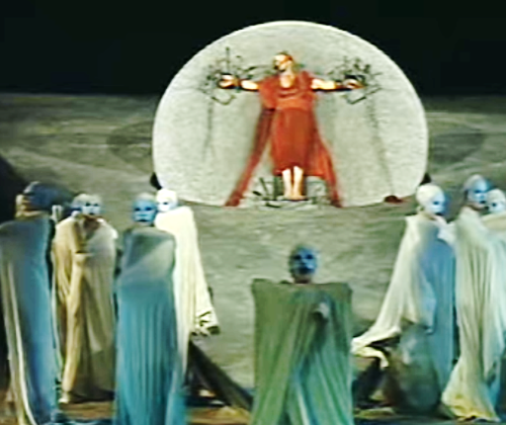
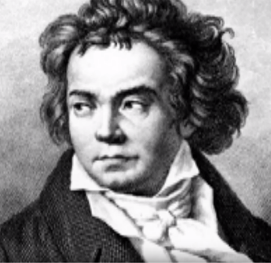
Aeschylus
Prometheus Bound
Mankind and Mathematics
Prometheus was chained for punishment on a high rock because he brought salvation to man, not only by steeling the gods’ fire (energy), but also by giving man also numbers and their meaning. Prometheus did not teach man only some useful topics. He taught him how he would use his mind, how he would plan for the future, how he would develop concepts and how he would exercise his logic. Thus, already 2,500 years ago, Aeschylus in his “Prometheus Bound” confirms the importance of numbers for mankind.
https://www.youtube.com/watch?v=kcWdcGwd844
This is what is behind the work of Ludwig van Beethoven “The Creatures of Prometheus”
Fact is, that adults need a minimum knowledge of numeracy to survive in our world. Numeracy is increasingly necessary in a wide range of life-skills, such as
personal finance,
data handling,
at daily work and
in everyday transactions.
https://www.youtube.com/watch?v=PuzRbxU1X1Q&t=33s
Math-GAMES Methodology 1

Slide 6
Each person needs a minimum knowledge of numeracy.
Numeracy is like literacy increasingly necessary in a wide range of life-skills.
The basic life-skills are obviously reflected in the main goals of mathematics education, which will prepare people to
solve problems
communicate and reason
make connections between mathematics and its applications
become mathematically literate
appreciate and value mathematics
make informed decisions as contributors to society.
Particularly in the case of Slow Adults Learners the impact during regular lessons shows deficits on the
motivational,
emotional,
cognitive and
social aspects.
The result is: 13% of all adults have a lack of knowledge in arithmetic.
Math-GAMES Methodology 2

Slide 7
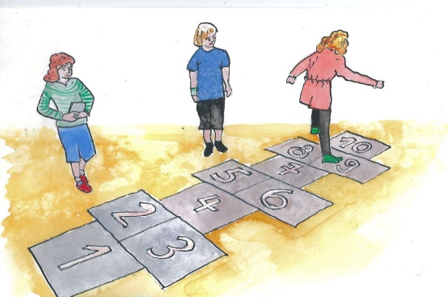
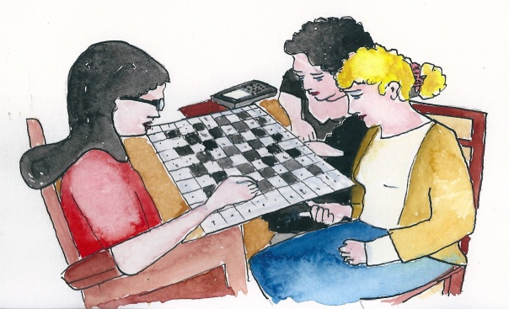
This causes playing when learning Mathematics:
Great learning motivation by working with things that make pleasure
High learning effect by joy in the matter
Social behaviour in solving problems is promoted
Speaking and language skills are encouraged to play, important for the understanding of mathematical tasks
In Mathematics, as in the game, there is always a model for reality
When playing certain games, the motoric skills are encouraged
Solution strategy and mathematical rules are applied
This causes playing in humans:
Playing is fun
Playing together builds human relationships
Playing strengthens creativity
Playfully problems are solved
When playing, you have to pay attention to the rules
This causes playing with the learning behaviour:
Interest is aroused
Motivation is encouraged
Competition is socialization
Games represent reality as a model
A relaxed and cheerful environment is created when playing
Math-GAMES Methodology 3

Slide 8
Choose the right game!
Pay attention to the mathematical content to be learned
Search in the synopsis
Note the text in the compendium
See the page in the manual
Make the right material
Make sure that the game used is also motivated
Pay attention to the feelings of the learners and answer the questions:
Does he like to play alone?
Does he like to play with an opponent?
Does he like to play in the group?
What games does he like to play?
Note the different game types
Pure gambling (for example, dice, Domino)
Pure brain games (e.g., four-in-a-row, chess, mill, lady)
Combined games of brain and fortune (e.g., 17 and 4, Monopoly)
Movement games (e.g., seven-step dance, bouncy play)
Motorized games (e.g., Mikado, thread game)
Puzzles

Slide 9
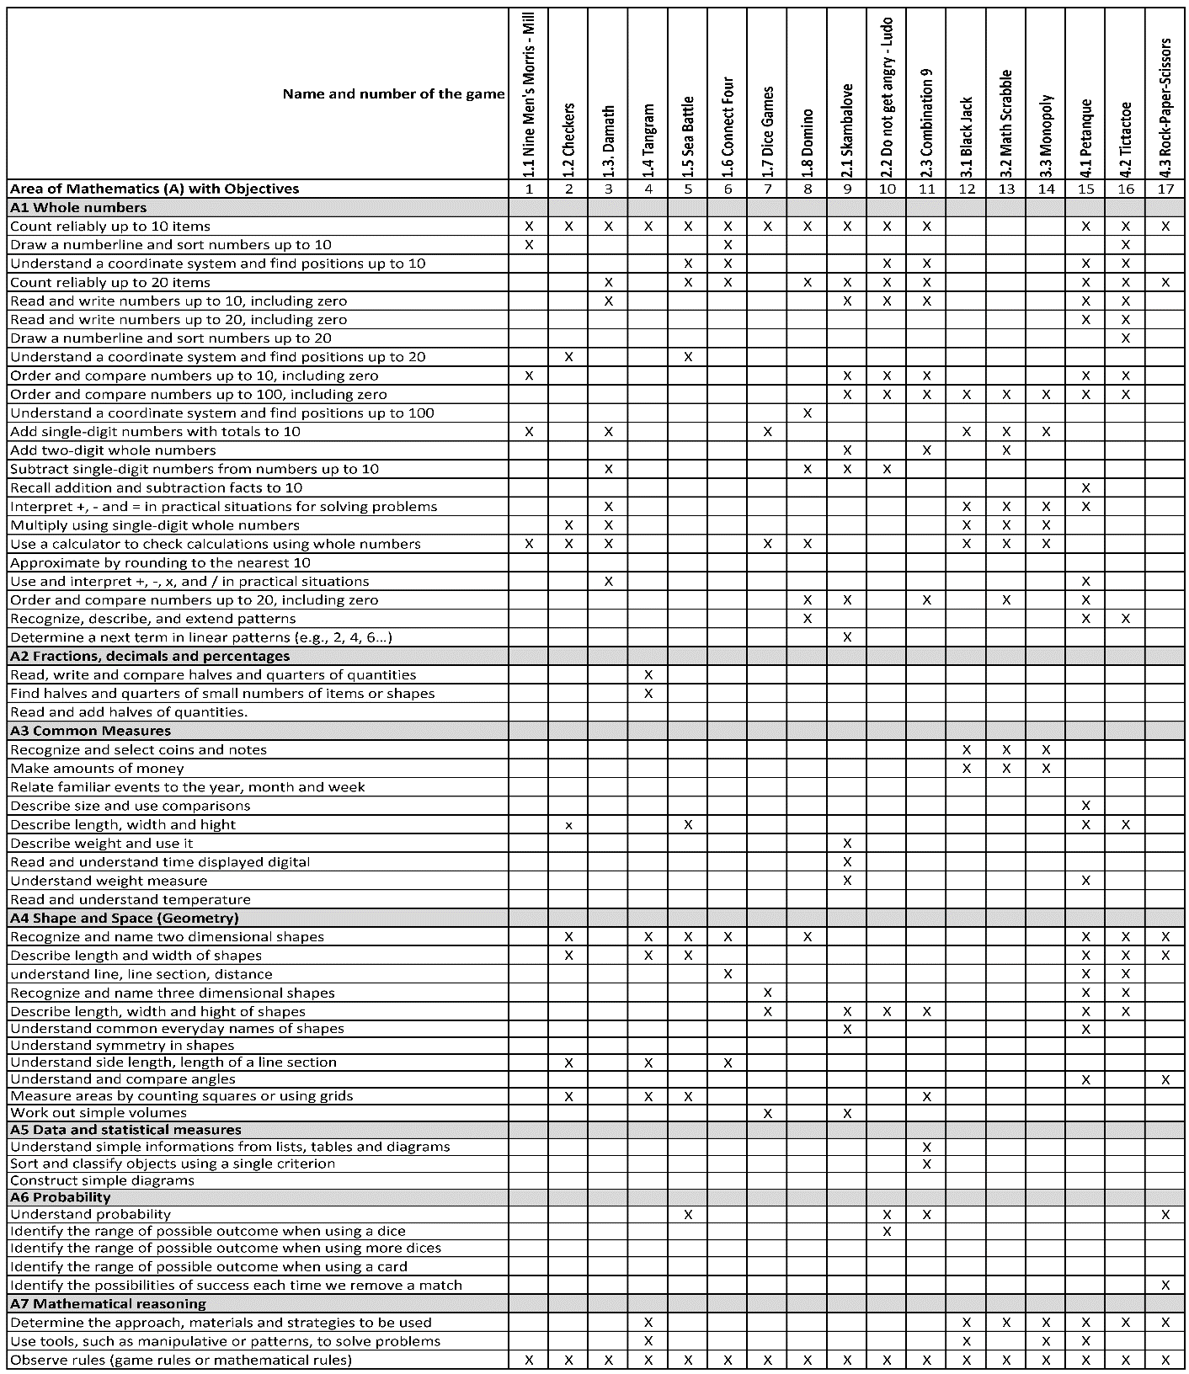

Slide 10
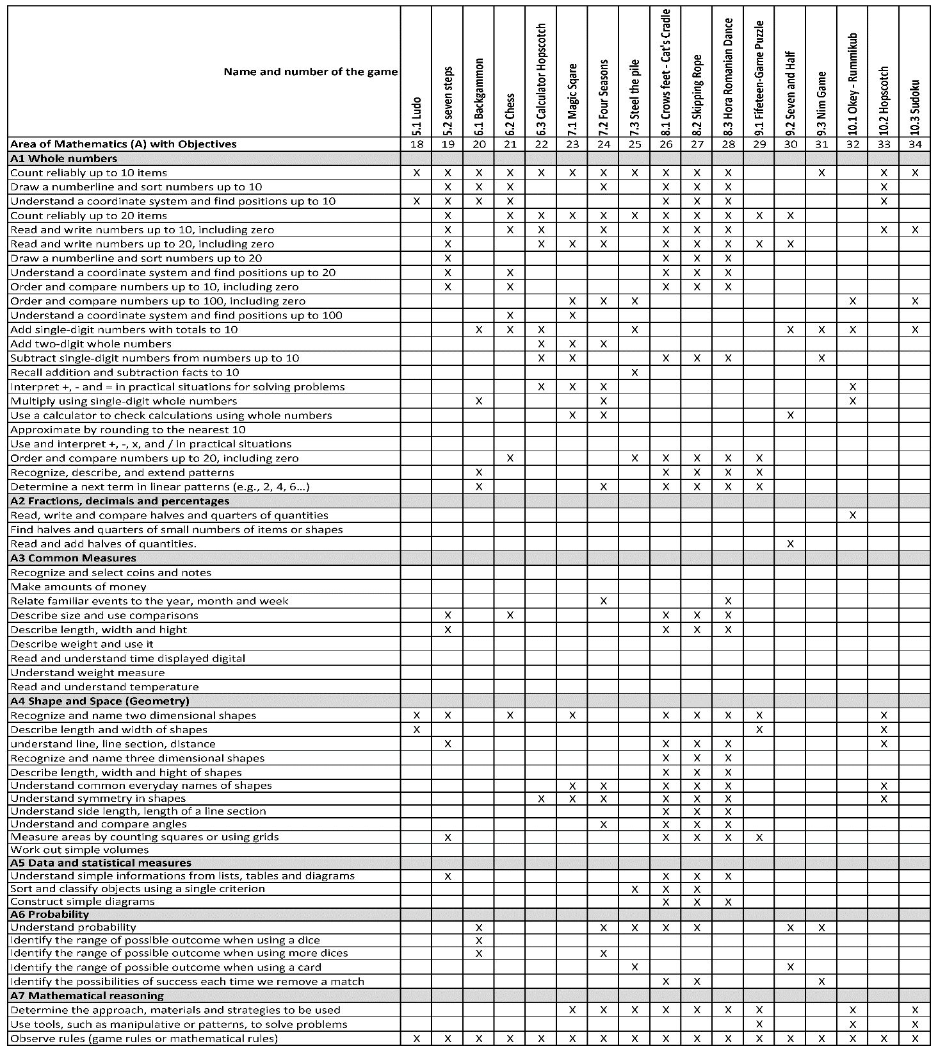

Slide 11
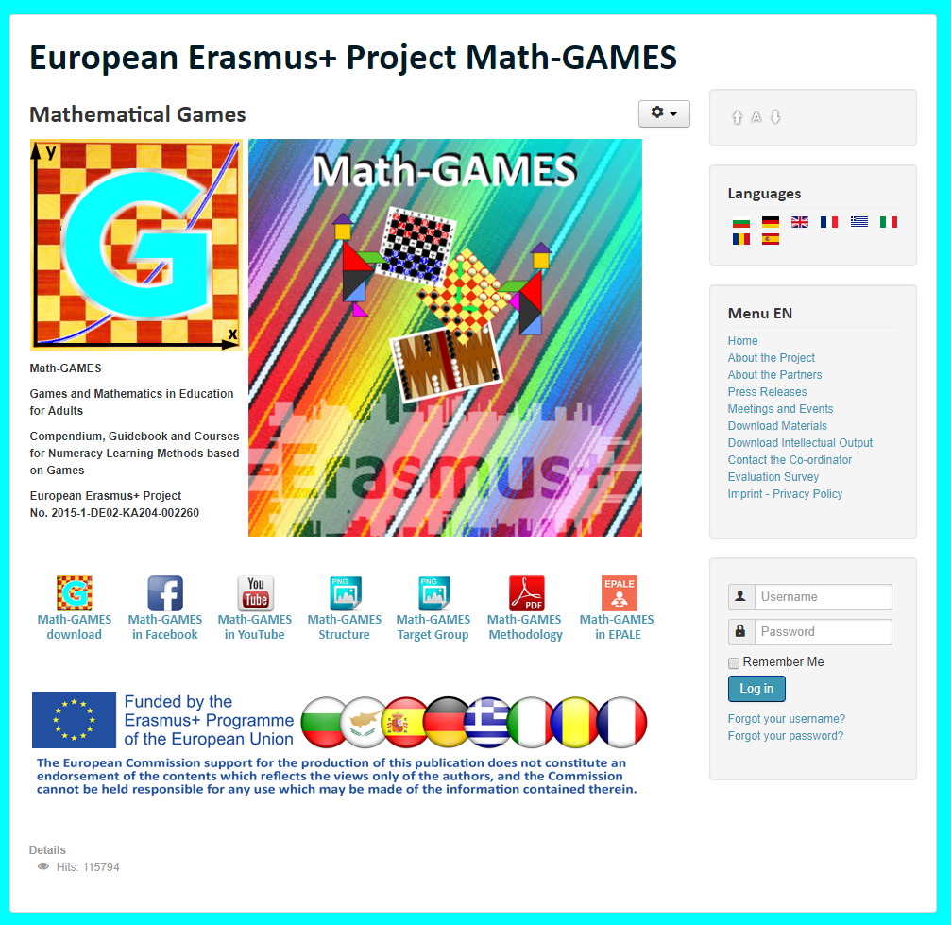
The result is: Play Games and and learn Mathematics more easily.
Our Project-Website will help you: www.math-games.eu

